Slide 1

Game Day The role of analytics in sport organizations to help increase revenues and create a better fan experience on matchdays
MASTER DEGREE PROGRAM IN
DATA SCIENCE AND ADVANCED ANALYTICS
BY SIMÃO EDUARDO RAMOS COSTA PEREIRA
Supervisor: Miguel de Castro Simões Ferreira Neto Co-Supervisor: João Bruno Morais de Sousa Jardim BI4All Mentor: Rui Valente
NOVA Information Management School Instituto Superior de Estatística e Gestão de Informação Universidade Nova de Lisboa

Slide 2

AGENDA
Introduction
Objectives
Literature Review
Methodology
Results
Conclusion
Future Work
Discussion

Slide 3
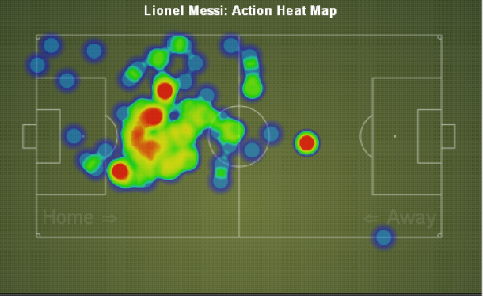
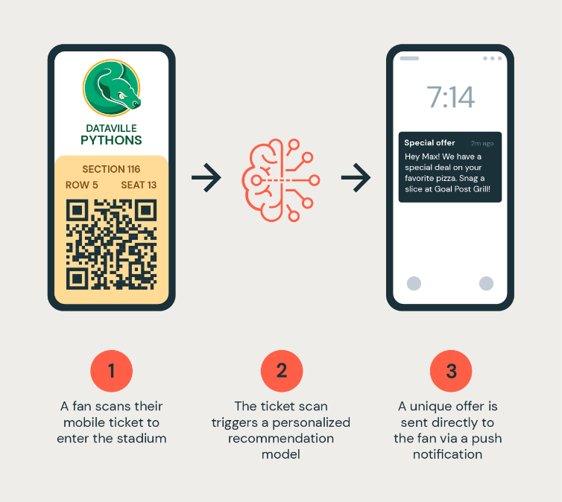
INTRODUCTION
Sports beyond performance: Modern sports organizations are major economic and financial entities with necessity to remain competitive in and outside the field.
Role of analytics and big data in sports: Essential in measuring and improving athlete performance but also crucial in harnessing data from fans and stakeholders.
Emergence of data departments: Sports clubs forming analytics/data science teams with the goal of increasing revenues, reduce costs, enhance fan experiences.
Focus on fans: Recognizing fans as the primary revenue source. Enhancing fan experience and value for sustained growth.

Slide 4



OBJECTIVES
Exploration and innovation Showcasing how analytics and big data can have a transformative role in the sports industry and how many functionalities one can deploy in this field.
Enhancement focus Specifically aimed at improving fan experience and boosting revenue for sports organizations.
Real-world relevance Build a BI solution in real world use cases capable of showcasing how data and analytics can be leveraged to benefit both organizations and fans

Slide 5





LITERATURE REVIEW
Analytical Applications in Sports
Emerging Trends: Shift towards more extensive use of analytics for business and fan engagement (Ratten, V., Dickson, G., 2020).
Fan behaviour analysis - Social Media Analysis: Use of Hootsuite, Sprout Social, Brandwatch for fan sentiment analysis (Gong, X., Wang, Y., 2021).
Food, Beverage, and Merchandising Analytics - Revenue Enhancement Strategies: Research by Sutton, W. A., et al. (2020) on the impact of analytics in these domains. Sutton, W. A., et al. (2020)
Fan Engagement Analytics - Technological Influence: Studies by Caulfield, J., Jha, A. K. (2022) on technology's role in enhancing fan involvement and spending.
Cloud Applications in Sports- Case Study: NBA's use of Azure for fan experience (Microsoft., 2021).
Technological tools for used for analytics in sports
CRM and BI Tools -Role of Salesforce, Microsoft Dynamics, SAP (Apostolou, K., Tjortjis, C. 2019), Tableau, and Power BI in data analysis (Venugopal, S., 2023).
Social Media Analysis -Use of Hootsuite, Sprout Social, Brandwatch for fan sentiment analysis (Gong, X., Wang, Y., 2021
Cloud capabilities -(Bouquet, P., Molinari, A., Bortolan, L., Dal Pra, A., Bezzi, G., & Vettorato, S., 2022).

Slide 6
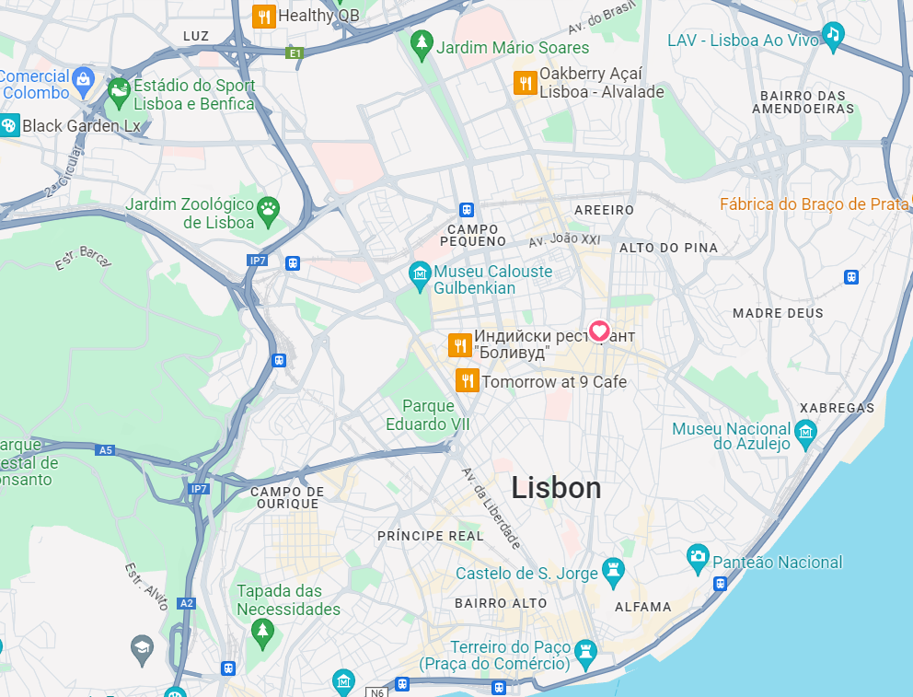

METHODOLOGY
Use Case 1 Real time access to a data warehouse and taking live actions.
USE CASES
Use Case 2 Using real-time location on a matchday to interact with the fans.
Considerations
In both use cases we consider the football club Sport Lisboa e Benfica and matches that occur in its stadium, Estádio da Luz in Lisbon (Latitude = 38.752711 and Longitude = -9.1847739).
The main focus of both use cases was developing the BI solution, not the software application itself.

Slide 7



METHODOLOGY USE CASE 1: REAL TIME ACCESS TO A DATA WAREHOUSE AND TAKING LIVE ACTIONS
Before the match
if the club's database indicates that a specific fan does not possess a ticket five hours before the match, an email can be sent as a reminder to purchase tickets.
LIVE ACTIONS
At halftime
If the club's database confirms that a specific fan holds a ticket for the game, a notification can be sent at halftime featuring promotional offers.
How:
To deploy these actions, Python was used to connect to Azure SQL Database and leverage the data warehouse, enabling the sending of personalized emails.

Slide 8
METHODOLOGY USE CASE 1: REAL TIME ACCESS TO A DATA WAREHOUSE AND TAKING LIVE ACTIONS
FANS SQL TABLE
FANS_DETAILS SQL TABLE
Simulation of what could be Benfica's datawarehouse. This model is also used for the second use case.
MATCHES SQL TABLE
STADIUM OCCUPANCY (FOR MATCH_ID =1) SQL TABLE

Slide 9
METHODOLOGY USE CASE 1: REAL TIME ACCESS TO A DATA WAREHOUSE AND TAKING LIVE ACTIONS
Action before the match:
-Is it 5 hours before the match ?
-Fan has ticket ?

Slide 10
RESULTS USE CASE 1: REAL TIME ACCESS TO A DATA WAREHOUSE AND TAKING LIVE ACTIONS

Slide 11
METHODOLOGY USE CASE 1: REAL TIME ACCESS TO A DATA WAREHOUSE AND TAKING LIVE ACTIONS
Action at halftime:
-Is it halftime ?
-Does the fan have a ticket for the match?

Slide 12
RESULTS USE CASE 1: REAL TIME ACCESS TO A DATA WAREHOUSE AND TAKING LIVE ACTIONS

Slide 13
METHODOLOGY USE CASE 2: USING REAL-TIME LOCATION ON A MATCHDAY TO INTERACT WITH THE FANS
Action 1
If the distance of the fan to Estádio da Luz is more than 5km and it is less than 3 hours to the kick-off
LIVE ACTIONS
Action 2
If the fan is less than 5km away from the stadium and the game starts within 3 hours.
Architecture benefits:
- Architecture enables the ingestion of real-time fan location and facilitates immediate actions
- Capacity to store data for a future in-depth analysis (SQL Database)
- Real time data visualization (Power BI)

Slide 14
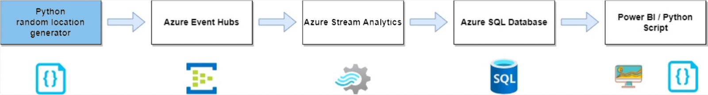
METHODOLOGY USE CASE 2: USING REAL-TIME LOCATION ON A MATCHDAY TO INTERACT WITH THE FANS
The code generates random location coordinates(latitude and longitude) for 10 fans in the Lisbon area.
Python sends event data at regular intervals through its capability to connect to an azure event hub using the provided string and event hub name. connection

Slide 15
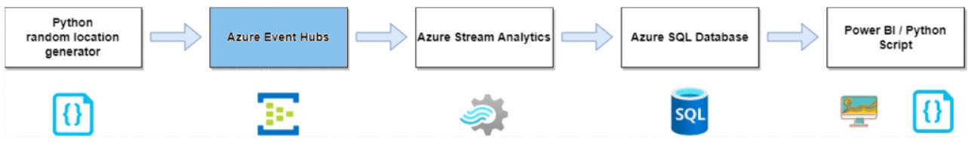
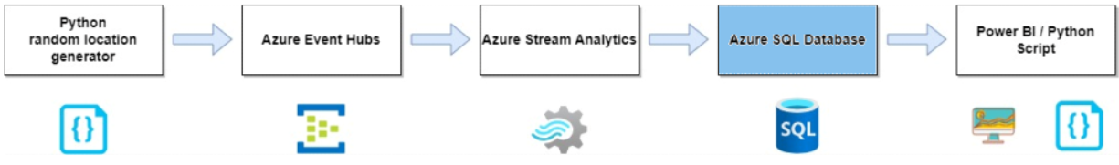
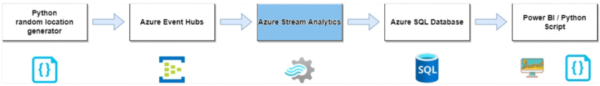
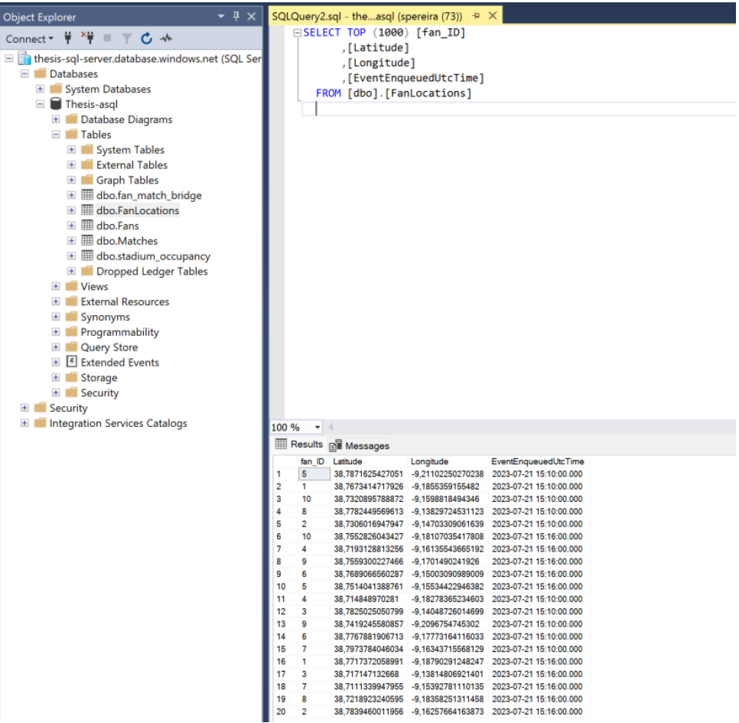
RESULTS USE CASE 2: USING REAL-TIME LOCATION ON A MATCHDAY TO INTERACT WITH THE FANS

Slide 16
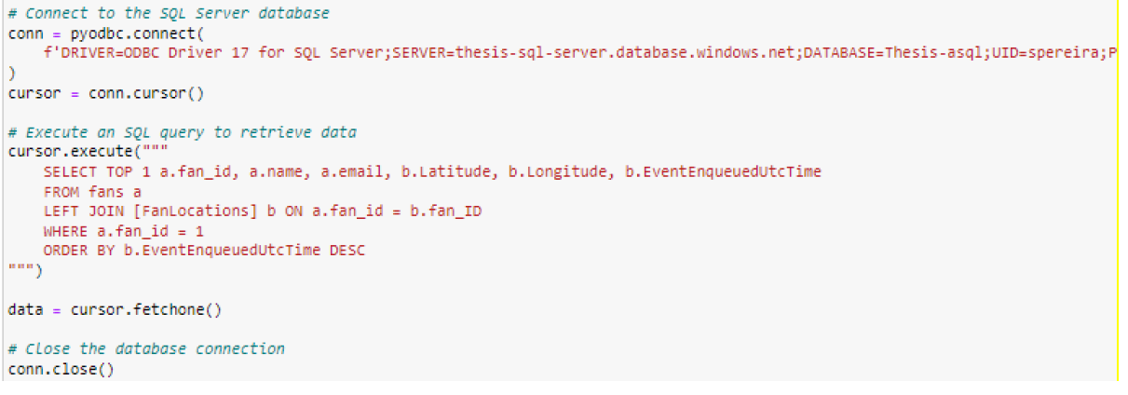
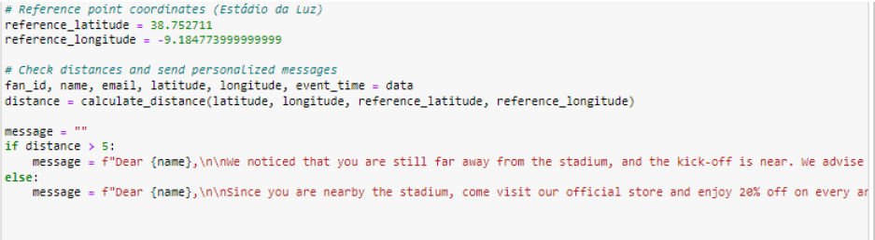
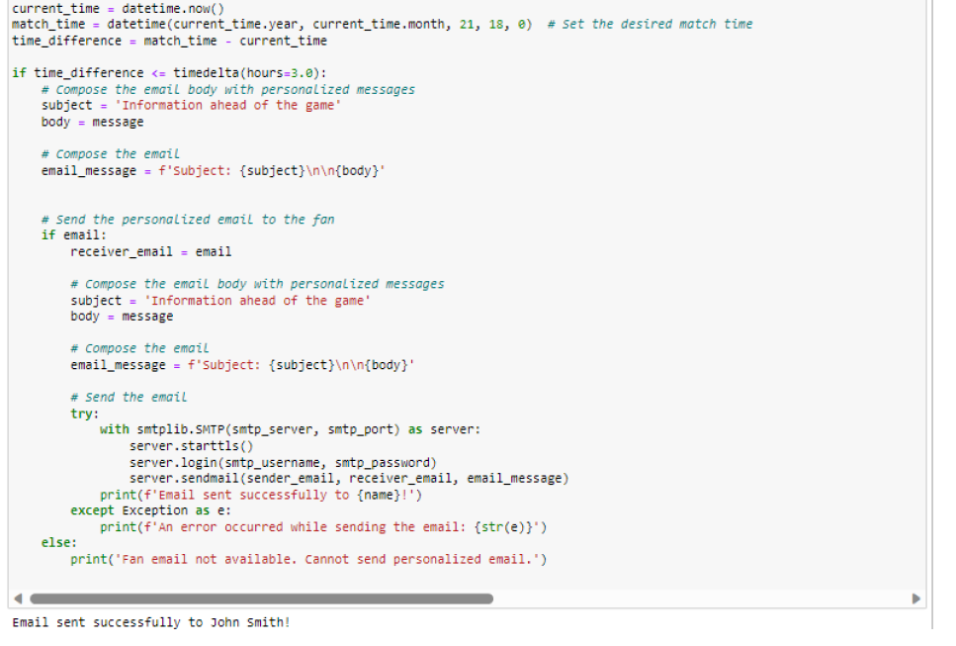
METHODOLOGY USE CASE 2: USING REAL-TIME LOCATION ON A MATCHDAY TO INTERACT WITH THE FANS

Slide 17

RESULTS USE CASE 2: USING REAL-TIME LOCATION ON A MATCHDAY TO INTERACT WITH THE FANS
Action 1
3 hours before the match
More than 5 km away from Estádio da Luz
Action 2
3 hours before the match
Less than 5 km away from Estádio da Luz

Slide 18
RESULTS USE CASE 2: USING REAL-TIME LOCATION ON A MATCHDAY TO INTERACT WITH THE FANS

Slide 19
CONCLUSION
Accomplishments
Illustrated how data and analytics can be used to optimize operations, fan engagement as well as organizations revenue
Showcased some of possibilities on how the sports industry can benefit from leveraging its data.
Leveraging historical databases of sport entities and perform live actions for optimizing club operations, merchandising strategies and fans experience.
Ingestion of real time events (live location) were used to immediately interact with the fans and it was shown how this data can be used for instant actions and also for future analysis.
The tecnhonologies used such as Azure Cloud create a innovative and effective solution in the area of study.

Slide 20




FUTURE WORK
Expanding Use Cases: Explore more aspects of fan engagement for a comprehensive understanding of BI applications.
Advanced Cloud Features: Allocate more resources to examine more sophisticated and different cloud service capabilities.
Data Diversity and Volume: Integrate various data types for example like live traffic, ticket information, and weather data for richer analysis.
Practical Application Testing: Develop or utilize an existing sports mobile app to test the BI solution on a larger dataset for empirical validation.

Slide 21
Thank you!

